Slide 1


Dual Integral Quadratic Constraints for Robust Control of Partial Integral Equations
An engineering overview
T.M. Lenssen – supervisor: Amritam Das
CS – System & Control / 30-09-2026

Slide 2



Rigid body representation
Ordinary Differential Equation (ODE)
Flexible body representation
Partial Differential Equation (PDE)
Notes:
This slide serves as an intuitive yet insightful slide to explain PDEs, it shows the limitations of a rigid body representation as we push for performance where partial differential equations could better capture the flexmodes of the system such that we can account for them in analysis, observation or controlling the system.
That additional detail comes with greater complexity: PDE models involve infinitely many modes, spatial distributed dynamics, and boundary conditions, making analysis and design more challenging.

Slide 3





ASML wafer stage
Canon Production Printing
Parkinsons Disease
Wave/beam equations (PDE)
Diffusion-Reaction Equations (PDE)
Differential Delay Equations
(DDE -> PDE)
Notes:
This is especially relevant at ASML, where we want to achieve as much throughput as possible. The wafer stage carries the chips and needs to move as fast as possible, while still reaching nanometer-level precision.
This creates a trade-off between weight and stiffness. A lighter stage can move faster under the same forces, but it also becomes more flexible, which makes it harder to position accurately. As we saw on the previous slide, this flexibility can be described using partial differential equations instead of ordinary, or lumped, differential equations. Typical examples are wave and beam equations.
Another example is large-scale production printing at Canon in Venlo. If a wet piece of paper dries in an uncontrolled way, it can wrinkle or deform. The same problem appears in printing, because the paper becomes slightly wet during the printing process and then needs to be dried in a controlled way.
Again, there is a trade-off between throughput and quality. Drying faster increases production speed, but if the temperature or moisture is not distributed evenly across the paper, the paper can deform. Since heat and moisture vary across both space and time, this again naturally leads to partial differential equations.
The final, seemingly unrelated example is Parkinson’s disease. In a healthy person, the cortex generates possible actions and sends this information to the basal ganglia. The basal ganglia help select which actions should be carried out and which should be suppressed. This information is then passed through the thalamus back to the motor cortex, which helps execute the movement.
In patients with Parkinson’s disease, this selection mechanism is disturbed because of a loss of dopamine. As a result, the basal ganglia suppress movement too strongly, making it harder to start and control movements. This leads to symptoms such as slow movement, stiffness, and tremor.
Although this problem looks very different from a wafer stage or a drying sheet of paper, it also involves dynamics that are distributed over space. In all three examples, the main challenge is the same: we want to understand and control systems whose behavior cannot be described well by only a few lumped variables.

Slide 4
Partial Integral Equations
Equivalent dynamics
Built in boundary conditions
Bounded operators
Matrix-like algebra
LMI-like computations
Controller synthesis for linear systems…..
ODE-PDE
PIE
Exact!
Notes:
Partial Differential Equations give a natural way to describe distributed systems, but stability analysis, observer design, and controller synthesis are challenging. Spatially distributed dynamics and boundary conditions complicate the application of large amount of theory that has been developed for ordinary differential equations.
More recently, partial differential equations have been introduced as an alternative representation that brings much of the properties of ODEs to partial differential equations.

Slide 5


Partial Integral Equations
Equivalent dynamics
Built in boundary conditions
Bounded operators
Matrix-like algebra
LMI-like computations
Controller synthesis for linear systems…..
ODE-PDE
PIE
Exact!
$$\dot{T}\left(t,s\right)=T\left(t,s\right)$$
$$T\left(t,0\right)=w_{1}\left(t\right)$$
$$T_{s}\left(t,0\right)=w_{2}(t)$$
$$\begin{aligned}\dot{u}\left(t,s\right)=w_{1}\left(t\right) \\ +sw_{2}\left(t\right) \\ +\int_{0}^{s}{\left(s−ξ\right)}u_{ξξ}\left(t,ξ\right)dξ\end{aligned}$$
Notes:
Partial Differential Equations give a natural way to describe distributed systems, but stability analysis, observer design, and controller synthesis are challenging. Spatially distributed dynamics and boundary conditions complicate the application of large amount of theory that has been developed for ordinary differential equations.
More recently, partial differential equations have been introduced as an alternative representation that brings much of the properties of ODEs to partial differential equations.

Slide 6
Partial Integral Equations
Equivalent dynamics
Built in boundary conditions
Bounded operators
Matrix-like algebra
LMI-like computations
Controller synthesis for linear systems…..
ODE-PDE
PIE
Exact!
$$𝒯{\dot{x}}_{f}\left(t\right)=𝒜x_{f}\left(t\right)+ℬw\left(t\right)$$
$$z\left(t\right)=𝒞x_{f}\left(t\right)+𝒟w\left(t\right)$$
$$𝒯,𝒜,....∈Π_{4}$$
Notes:
Partial Differential Equations give a natural way to describe distributed systems, but stability analysis, observer design, and controller synthesis are challenging. Spatially distributed dynamics and boundary conditions complicate the application of large amount of theory that has been developed for ordinary differential equations.
More recently, partial differential equations have been introduced as an alternative representation that brings much of the properties of ODEs to partial differential equations.

Slide 7
Partial Integral Equations
Equivalent dynamics
Built in boundary conditions
Bounded operators
Matrix-like algebra
LMI-like computations
Controller synthesis for linear systems…..
ODE-PDE
PIE
Exact!
$$𝒜+ℬ∈Π_{4}, 𝒜ℬ∈Π_{4}, 𝒜^{∗}∈Π_{4}, \left[\begin{matrix}𝒜 & ℬ\end{matrix}\right]∈Π_{4}$$
Notes:
Partial Differential Equations give a natural way to describe distributed systems, but stability analysis, observer design, and controller synthesis are challenging. Spatially distributed dynamics and boundary conditions complicate the application of large amount of theory that has been developed for ordinary differential equations.
More recently, partial differential equations have been introduced as an alternative representation that brings much of the properties of ODEs to partial differential equations.

Slide 8
Partial Integral Equations
Equivalent dynamics
Built in boundary conditions
Bounded operators
Matrix-like algebra
LMI-like computations
Controller synthesis for linear systems…..
ODE-PDE
PIE
Exact!
Exponential stability of PDE
$$∃𝒫≻0, 𝒯^{∗}𝒫𝒜+𝒜^{∗}𝒫𝒯⪯−α𝒯^{∗}𝒫𝒯$$
Notes:
Partial Differential Equations give a natural way to describe distributed systems, but stability analysis, observer design, and controller synthesis are challenging. Spatially distributed dynamics and boundary conditions complicate the application of large amount of theory that has been developed for ordinary differential equations.
More recently, partial differential equations have been introduced as an alternative representation that brings much of the properties of ODEs to partial differential equations.

Slide 9
Partial Integral Equations
Equivalent dynamics
Built in boundary conditions
Bounded operators
Matrix-like algebra
LMI-like computations
Controller synthesis for linear systems…..
ODE-PDE
PIE
Exact!
Notes:
Partial Differential Equations give a natural way to describe distributed systems, but stability analysis, observer design, and controller synthesis are challenging. Spatially distributed dynamics and boundary conditions complicate the application of large amount of theory that has been developed for ordinary differential equations.
More recently, partial differential equations have been introduced as an alternative representation that brings much of the properties of ODEs to partial differential equations.

Slide 10



$${heat}_{t}\left(t,s\right)=0.01 {heat}_{ss}\left(t,s\right)+\left[\underset{\text{heat generation}}{\underbrace{0.25\left(1+δ\right)}}−\underset{\text{cooling}}{\underbrace{0.2}}\right]heat\left(t,s\right)+u\left(t\right)$$
$$δ∈[−0.5,0.5]$$
Solved during internship
Notes:
To explain robust control, let’s take a simplified version of our printing process. See here the model of a cross-section of a piece of paper. For illustrative purposes, suppose it is heated up during the printing process, after which it needs to be cooled. Let’s also suppose our piece of paper is very poor at conducting heat.
This cooling is affected by the ambient temperature in the spot where the printer is situated, which can deviate from day to day, for example due to the weather or air-conditioning settings. This deviation is captured by the variable $δ$. As we increase $δ$, we increase the ambient temperature and thus make it more difficult for our paper to cool down.
At some point, our poorly heat-conducting paper can no longer dissipate enough heat and no longer behaves as desired and thus start to heat up. One example of robust analysis is then to determine for which values of $δ$the paper still cools down properly, without having to simulate the system for an infinite number of possible values of $δ$.
This robust analysis problem was the focus of my internship. For my graduation thesis, I then took the next step and focused on robust control: not only determining whether the system behaves correctly under uncertainty, but designing a controller that makes sure it does.

Slide 13

[1] beta oscillatory activity in basal ganglia
Notes:
This is the current consensus around the inner workings of the basal ganglia
Dit laat de connectie tussen de verschillende neuronen populaties zien. Deze populaties communiceren met elkaar doormiddel van het sturen van spikes een kleine Bij patienten met parkinson

Slide 14

$$\begin{aligned}z_{S}\left(t\right)&=−x_{G}\left(t−τ_{GS}\right), \\ z_{G}\left(t\right)&=x_{S}\left(t−τ_{SG}\right)−x_{G}\left(t−τ_{GG}\right), \\ \\ \end{aligned}$$
[2] Firing rate models
Notes:
In de praktijk wordt er een elektrode op de stn gezet om deep brain stimulation.
Correlatie tussen oscilatie en traagheid van bewegingen. Dus de vraag is dan kunnen we het brein zo stimuleren dat we de oscilaties verminderen
Remende effect is inhibitory
Gaspedaal is exhibitory

Slide 15

$$\begin{aligned}z_{S}\left(t\right)&=−x_{G}\left(t−τ_{GS}\right), \\ z_{G}\left(t\right)&=x_{S}\left(t−τ_{SG}\right)−x_{G}\left(t−τ_{GG}\right), \\ \\ \end{aligned}$$
[2] Firing rate models
Notes:
In de praktijk wordt er een elektrode op de stn gezet om deep brain stimulation.
Correlatie tussen oscilatie en traagheid van bewegingen. Dus de vraag is dan kunnen we het brein zo stimuleren dat we de oscilaties verminderen
Remende effect is inhibitory
Gaspedaal is exhibitory

Slide 16

$$\begin{aligned}z_{S}\left(t\right)&=−w_{GS}x_{G}\left(t−τ_{GS}\right), \\ z_{G}\left(t\right)&=w_{SG}x_{S}\left(t−τ_{SG}\right)−w_{GG}x_{G}\left(t−τ_{GG}\right), \\ \\ \end{aligned}$$
[2] Firing rate models
Notes:
In de praktijk wordt er een elektrode op de stn gezet om deep brain stimulation.
Correlatie tussen oscilatie en traagheid van bewegingen. Dus de vraag is dan kunnen we het brein zo stimuleren dat we de oscilaties verminderen
Remende effect is inhibitory
Gaspedaal is exhibitory

Slide 17

$$\begin{aligned}z_{S}\left(t\right)&=−w_{GS}x_{G}\left(t−τ_{GS}\right), \\ z_{G}\left(t\right)&=w_{SG}x_{S}\left(t−τ_{SG}\right)−w_{GG}x_{G}\left(t−τ_{GG}\right), \\ τ_{S}{\dot{x}}_{S}\left(t\right)&=δ_{S}\left(z_{S}\left(t\right)\right)−x_{S}\left(t\right), \\ τ_{G}{\dot{x}}_{G}\left(t\right)&=δ_{G}\left(z_{G}\left(t\right)\right)−x_{G}\left(t\right).\end{aligned}$$
Model contains delays and nonlinear activation funtions!
[2] Firing rate models
Notes:
In de praktijk wordt er een elektrode op de stn gezet om deep brain stimulation.
Correlatie tussen oscilatie en traagheid van bewegingen. Dus de vraag is dan kunnen we het brein zo stimuleren dat we de oscilaties verminderen
Remende effect is inhibitory
Gaspedaal is exhibitory

Slide 18

$$\begin{aligned}z_{S}\left(t\right)&=−w_{GS}x_{G}\left(t−τ_{GS}\right), \\ z_{G}\left(t\right)&=w_{SG}x_{S}\left(t−τ_{SG}\right)−w_{GG}x_{G}\left(t−τ_{GG}\right), \\ τ_{S}{\dot{x}}_{S}\left(t\right)&=δ_{S}\left(z_{S}\left(t\right)\right)−x_{S}\left(t\right)+u\left(t\right), \\ τ_{G}{\dot{x}}_{G}\left(t\right)&=δ_{G}\left(z_{G}\left(t\right)\right)−x_{G}\left(t\right).\end{aligned}$$
[2] Firing rate models
Notes:
In de praktijk wordt er een elektrode op de stn gezet om deep brain stimulation.
Correlatie tussen oscilatie en traagheid van bewegingen. Dus de vraag is dan kunnen we het brein zo stimuleren dat we de oscilaties verminderen
Remende effect is inhibitory
Gaspedaal is exhibitory

Slide 19
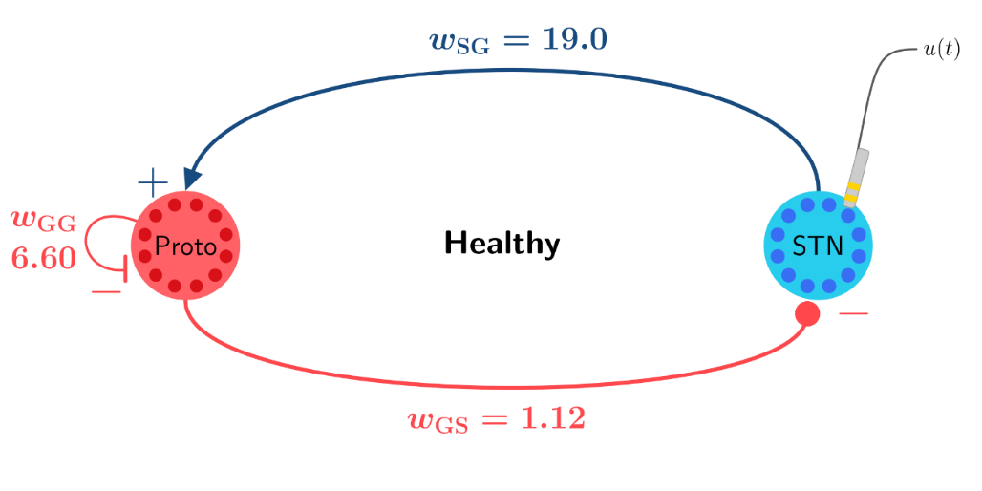

[2] Firing rate models
Notes:
In de praktijk wordt er een elektrode op de stn gezet om deep brain stimulation.
Correlatie tussen oscilatie en traagheid van bewegingen. Dus de vraag is dan kunnen we het brein zo stimuleren dat we de oscilaties verminderen
Remende effect is inhibitory
Gaspedaal is exhibitory

Slide 20
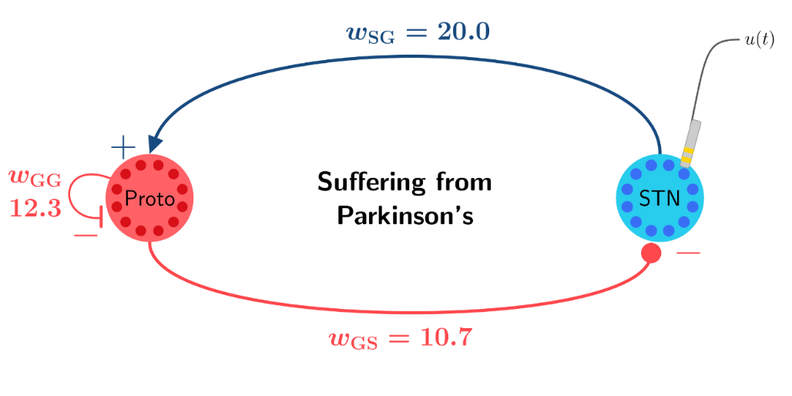

[2] Firing rate models
Notes:
In de praktijk wordt er een elektrode op de stn gezet om deep brain stimulation.
Correlatie tussen oscilatie en traagheid van bewegingen. Dus de vraag is dan kunnen we het brein zo stimuleren dat we de oscilaties verminderen
Remende effect is inhibitory
Gaspedaal is exhibitory

Slide 21
Goal: Develop a unified framework to analyse and control a broad class of Partial Integral Equations (PIEs).
Analysis capabilities
Duality argument
Convex state feedback synthesis

Slide 22
Goal: Develop a unified framework to analyse and control a broad class of Partial Integral Equations (PIEs).
Analysis capabilities
Duality argument
Convex state feedback synthesis

Slide 23
Goal: Develop a unified framework to analyse and control a broad class of Partial Integral Equations (PIEs).
Analysis capabilities
Duality argument
Convex state feedback synthesis

Slide 24
Goal: Develop a unified framework to analyse and control a broad class of Partial Integral Equations (PIEs).
Analysis capabilities
Duality argument
Convex state feedback synthesis
Main contributions

Slide 25
References
[1] B.De la Crompe, M.Deffains, A.Leblois, N.Mallet, “Reevaluating the role of the STN-Gpe network in generating beta synchronized oscillatory activity in parkinsonism.”
[2]A.J. Nevado Holgade, J.R.Terry,R.Bogacz, “Conditions for the Generation of Beta Oscillations in the Subthalamic Nucleus-Globus Pallidus Network”

